Slide 1
Biological Modeling of Neural Networks:
Week 12 – Decision models
12.1 Review: Population dynamics
- competition
12.2 Perceptual decision making
- V5/MT
- Decision dynamics: Area LIP
12.3 Theory of decision dynamics
- shared inhibition
- effective 2-dim model
12.4. Decisions in connected pops.
- unbiased case
- biased input
12.5. Decisions, actions, volition
- the problem of free will
Week 12 – Decision models:
Competitive dynamics
Wulfram Gerstner
EPFL, Lausanne, Switzerland
Notes:
Lecture 1, includes the
Blackboard part of the Salzman et al experiment
Blackboard part Reduction from 3 to 2 dimensions
Lecture 2
continuation of blackboard with linearization of the inhibitory neurons
Then Exercise 1, nullclines etc. from 10:25-10:38
Afterwards, the shifting nullclines, discussion of regimes, fixed points etc.
3rd lecture: Free will (12.5)

Slide 2
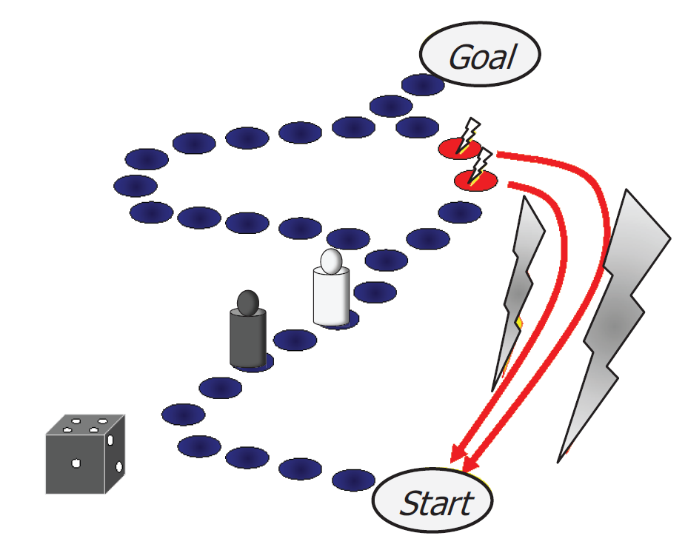
Week 12-part 1: How do YOU decide?

Slide 3
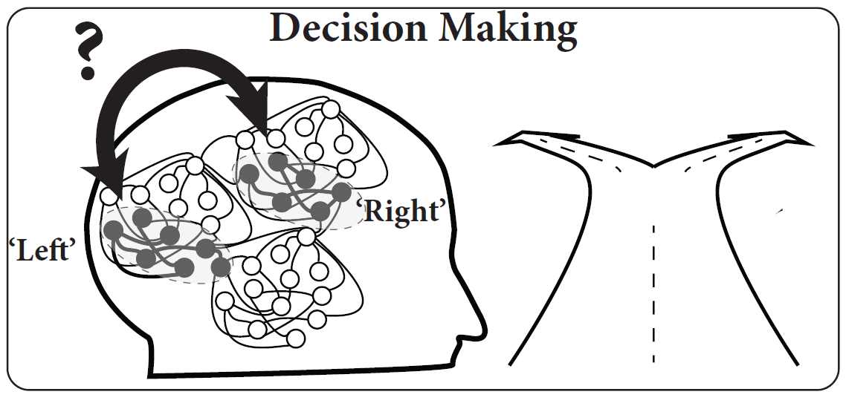
Week 12-part 1: Decision making
turn
Left? Right?

Slide 4
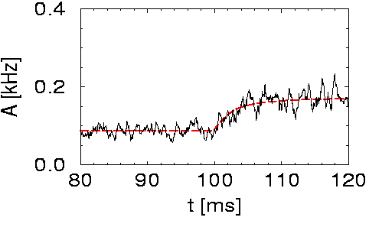
Week 12-part 1: Review: High-noise activity equation
Population activity
noise model A
(escape noise/fast noise)
Membrane potential caused by input
high noise
Attention:
- valid for high noise only, else
transients might be wrong
- valid for high noise only, else
spontaneous oscillations may arise
I(t)
h(t)
slow transient

Slide 5
Week 12-part 1: Review: microscopic vs. macroscopic
I(t)

Slide 6
Week 12-part 1: Competition between two populations
Input indicating
‘left’
Input indicating
‘right’

Slide 7
Week 12-part 1: How do YOU decide?

Slide 8
Biological Modeling of Neural Networks:
Week 12 – Decision models
12.1 Review: Population dynamics
- competition
12.2 Perceptual decision making
- V5/MT
- Decision dynamics: Area LIP
12.3 Theory of decision dynamics
- shared inhibition
- effective 2-dim model
12.4. Decisions in connected pops.
- unbiased case
- biased input
12.5. Decisions, actions, volition
- the problem of free will
Week 12 – Decision models:
Competitive dynamics
Wulfram Gerstner
EPFL, Lausanne, Switzerland

Slide 9

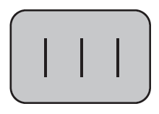


Week 12-part 2: Perceptual decision making?
‘Is the middle bar shifted to the left or to the right?’

Slide 10
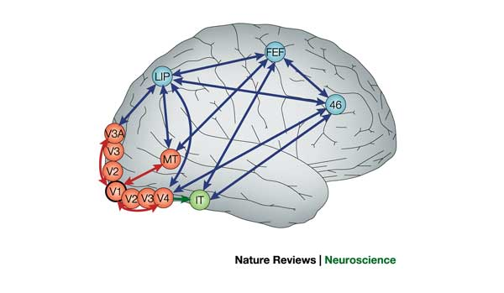
Week 12-part 2: Detour: receptive fields in V5/MT
visual
cortex
IMAGE
1) Cells in visual cortex MT/V5 respond
to motion stimuli
2) Neighboring cells in visual cortex MT/V5
respond to motion in similar direction
cortical columns
Albright, Desimone,Gross,
J. Neurophysiol, 1985

Slide 11
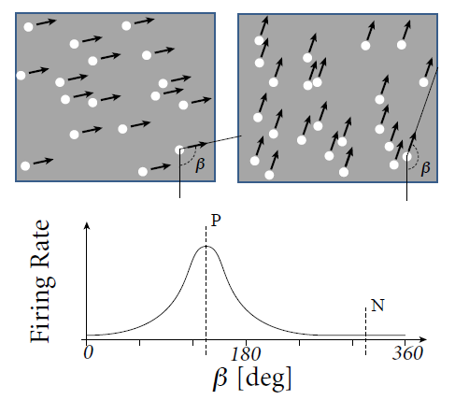
Week 12-part 2: Detour: receptive fields in V5/MT
Recordings from a single neuron in V5/MT
Receptive Fields depend
on direction of motion
Random moving dot stimuli:
e.g.Salzman, Britten, Newsome, 1990
Roitman and Shadlen, 2002
Gold and Shadlen 2007

Slide 12
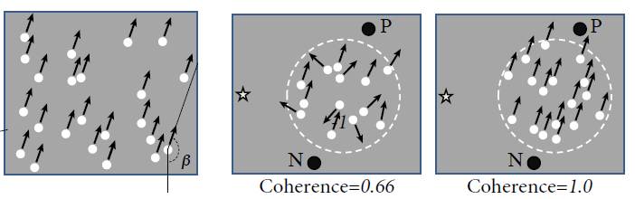
Week 12-part 2: Detour: receptive fields in V5/MT
Receptive Fields depend
on direction of motion: β = preferred direction = P

Slide 13
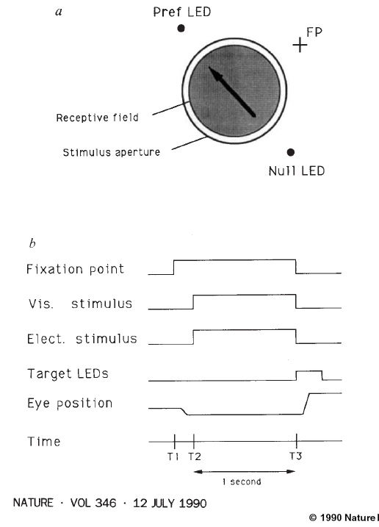
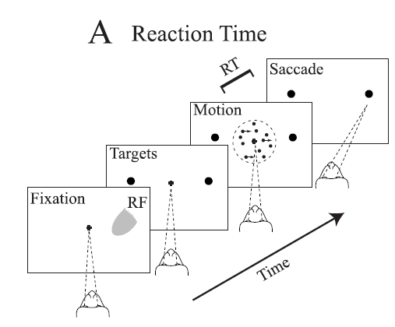
Week 12-part 2: Experiment of Salzman et al. 1990
coherence 0.8=80%
coherence 0.5 = 50%
coherence 0.0
Eye movement
coherence -1.0
opposite
direction
Image: Salzman, Britten, Newsome, 1990

Slide 14
Week 12-part 2: Experiment of Salzman et al. 1990
Monkey behavior w. or w/o Stimulation
of neurons in V5/MT
N
Monkey
chooses right
P
fixation
Visual stim.
LED
-1.0
0.5
0.5
1.0
X = coherent motion
to bottom right
Salzman, Britten,
Newsome, 1990
No bias, each point
moves in random direction
Blackboard:
Motion detection/stimulation

Slide 15
Week 12-part 2: Experiment of Salzman et al. 1990
coherence 0.8=80%
coherence 0.5 = 50%
coherence 0.0
excites this group of neurons
coherence -1.0

Slide 16
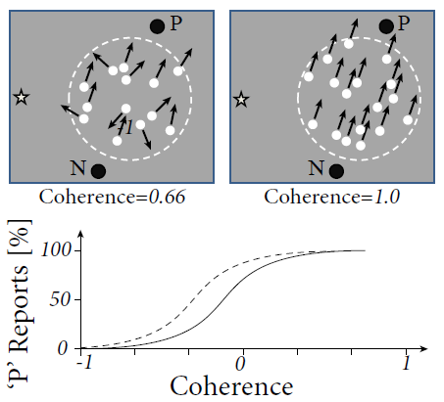
Week 12-part 2: Experiment of Salzman et al. 1990
Behavior: psychophysics
With stimulation

Slide 17
Biological Modeling of Neural Networks:
Week 12 – Decision models
12.1 Review: Population dynamics
- competition
12.2 Perceptual decision making
- V5/MT
- Decision dynamics: Area LIP
12.3 Theory of decision dynamics
- shared inhibition
- effective 2-dim model
12.4. Decisions in connected pops.
- unbiased case
- biased input
12.5. Decisions, actions, volition
- the problem of free will
Week 12 – Decision models:
Competitive dynamics
Wulfram Gerstner
EPFL, Lausanne, Switzerland

Slide 18
Week 12-part 2: Experiment of Roitman and Shadlen in LIP (2002)
coherence 85%
coherence 50%
RF of Neuron in LIP:
-selective to target of saccade
-increases faster if signal is stronger
- activity is noisy
coherence 0%
LIP is somewhere between
MT (movement detection) and Frontal Eye Field (saccade control)
Roitman and Shadlen 2002

Slide 19
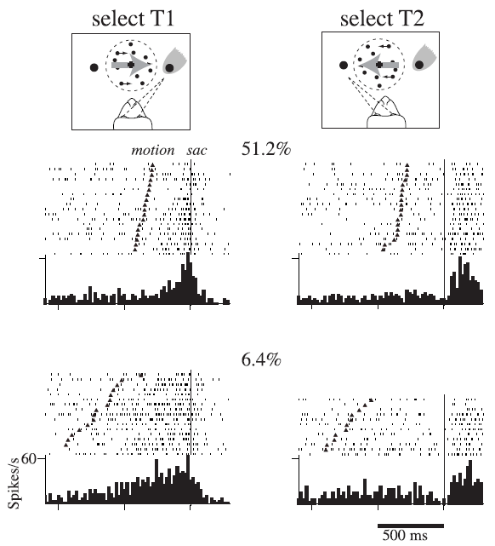
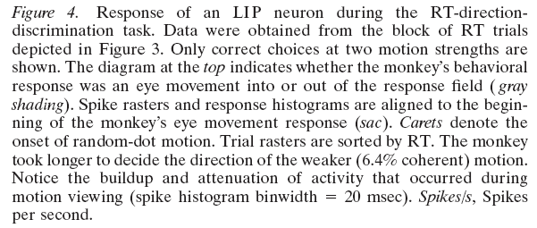
Week 12-part 2: Experiment of Roitman and Shadlen in LIP (2002)
Neurons in LIP:
-selective to target of saccade
-increases faster if signal is stronger
- activity is noisy
LIP is somewhere between MT (movement detection) and Frontal Eye Field
(saccade control)

Slide 20
Quiz 1, now
Receptive field in LIP
[ ] related to the target of a saccade
[ ] depends on movement of random dots

Slide 21
Biological Modeling of Neural Networks:
Week 12– Decision models, part 3
12.1 Review: Population dynamics
- competition
12.2 Perceptual decision making
- V5/MT
- Decision dynamics: Area LIP
12.3 Theory of decision dynamics
- shared inhibition
- effective 2-dim model
12.4. Decisions in connected pops.
- unbiased case
- biased input
12.5. Decisions, actions, volition
- the problem of free will
Week 12 – Decision models:
Competitive dynamics
Wulfram Gerstner
EPFL, Lausanne, Switzerland

Slide 22
Week 12-part 3: Theory of decision dynamics
activity equations
Membrane potential caused by input
Input indicating
left movement
Input indicating
right movement
Blackboard:
reduction from
3 to 2 equations
population activity

Slide 23
Population activity
activity equations
Inhibitory Population
Blackboard:
Linearized inhibition

Slide 24
Week 12-part 3: Effective 2-dim. model
activity equations
Membrane potential caused by input
Input indicating
left movement
Input indicating
right movement
population activity

Slide 25
Exercise 1 now: draw nullclines and flow arrows
h
1.0
1.0
0.8
0.2
0.0
1.0
0.8
0.2
0.0
Next Lecture at 10:36
Notes:
If we continue at 11:36, the timing will work out.

Slide 26
Week 12-part 3: Theory of decision dynamics
Phase plane, strong external input

Slide 27
Week 12-part 3: Theory of decision dynamics: biased input
Phase plane – biased input:
Population activity

Slide 28
Week 12-part 3: Theory of decision dynamics: unbiased weak
Phase plane – symmetric but small input
Weak external input:
Stable fixed point

Slide 29
Week 12-part 3: decision dynamics: unbiased strong to biased
Symmetric, but strong input
Phase plane

Slide 30
Week 12-part 3: Theory of decision dynamics: biased strong
Phase plane
Population activity
Biased input = stable fixed point
→ decision reflects bias

Slide 31
Week 12-part 3: Theory of decision dynamics: unbiased strong
Phase plane
Homogeneous solution
= saddle point
→ decision must be taken

Slide 32
Biological Modeling of Neural Networks:
Week 12– Decision models, part 3
12.1 Review: Population dynamics
- competition
12.2 Perceptual decision making
- V5/MT
- Decision dynamics: Area LIP
12.3 Theory of decision dynamics
- shared inhibition
- effective 2-dim model
12.4. Decisions in connected pops.
- unbiased case
- biased input
12.5. Decisions, actions, volition
- the problem of free will
Week 12 – Decision models:
Competitive dynamics
Wulfram Gerstner
EPFL, Lausanne, Switzerland

Slide 33
Week 12-part 4: Review: unbiased strong
Phase plane
Homogeneous solution
= saddle point
→ decision must be taken

Slide 34
Week 12-4: Review: unbiased weak
Phase plane – symmetric but small input
Weak external input:
Stable fixed point
→ no decision

Slide 35
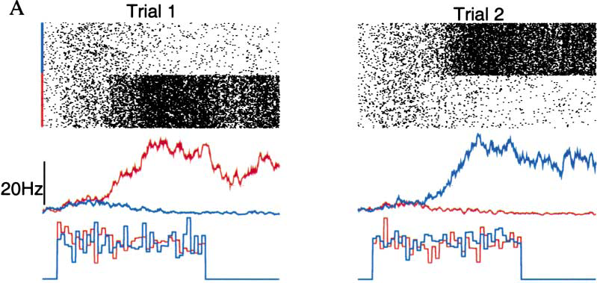
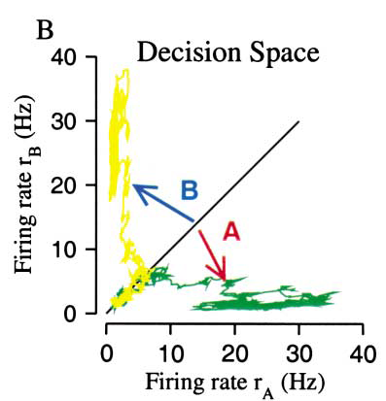
Simulation of 3 populations of spiking neurons, unbiased strong input
X.J. Wang, 2002
NEURON
Popul. 2
Popul.1
stimulus

Slide 36
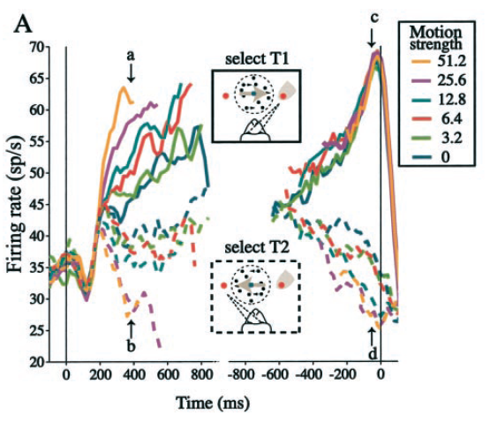
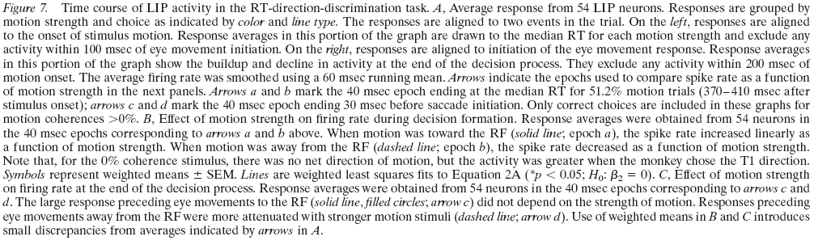
saccade onset
Stimulus onset
Roitman and Shadlen 2002
Notes:
End of second lecture

Slide 37
Biological Modeling of Neural Networks:
Week 12– Decision models, part 3
12.1 Review: Population dynamics
- competition
12.2 Perceptual decision making
- V5/MT
- Decision dynamics: Area LIP
12.3 Theory of decision dynamics
- shared inhibition
- effective 2-dim model
12.4. Decisions in connected pops.
- unbiased case
- biased input
12.5. Decisions, actions, volition
- the problem of free will
Week 12 – Decision models:
Competitive dynamics
Wulfram Gerstner
EPFL, Lausanne, Switzerland
Notes:
Third lecture starts here at 11:15

Slide 38
Week 12-5: Decision: risky vs. safe
How would you decide?
goal

Slide 39
How would you decide?
goal
Start

Slide 40
fMRI variant of Libet experiment
Decision and Movement
Preparation
-Subject decides spontaneously
to move left or right hand
- report when they made their decision
Libet, Behav. Brain Sci., 1985
Soon et al., Nat. Neurosci., 2008

Slide 41
What decides? Who decides?
‘Your brain decides what you want or what you prefer … ’
‘ … but your brain – this is you!!!’
Your experiences are memorized in your brain
Your values are memorized in your brain
Your decisions are reflected in brain activities
‘We don’t do what we want, but we want what we do’ (W. Prinz)
goal
goal
The problem of
Free Will
(see e.g. Wikipedia
article)
Start

Slide 42
Decision, Perception
and Competition in Connected Populations
Wulfram Gerstner
EPFL
Suggested Reading: - Salzman et al. Nature 1990
- Roitman and Shadlen, J. Neurosci. 2002
- Abbott, Fusi, Miller:
Theoretical Approaches to Neurosci.
- X.-J. Wang, Neuron 2002
- Libet, Behav. Brain Sci., 1985
- Soon et al., Nat. Neurosci., 2008
- free will, Wikipedia
Chapter 16, Neuronal Dynamics, Gerstner et al. Cambridge 2014

Slide 43
Last Lecture in 2 Weeks: (holiday next week)
- prepare questions for discussion section
Exam:
- written exam 17. 06. 2013 from 12:15-15:00
- miniprojects counts 1/3 towards final grade
For written exam:
-bring 1 page A5 of own notes/summary
-HANDWRITTEN!
The end

Slide 44
Nearly the end:
what can I improve for the students next year?
Integrated exercises?
Miniproject?
Overall workload ?(4 credit course = 6hrs per week)
Background/Prerequisites?
-Physics students
-SV students
-Math students
Comments: slides/notes

Slide 45
now QUESTION SESSION!
Questions to Assistants possible until June 4
The end
… and good luck for the exam!

Slide 46
Exercise 2.1 now: stability of homogeneous solution
Membrane potential caused by input
Assume:
a) Calculate homogeneous fixed point
b) Analyze stability of the fixed point h(b) as a function of b
Next Lecture at 11:15

